Slide 1
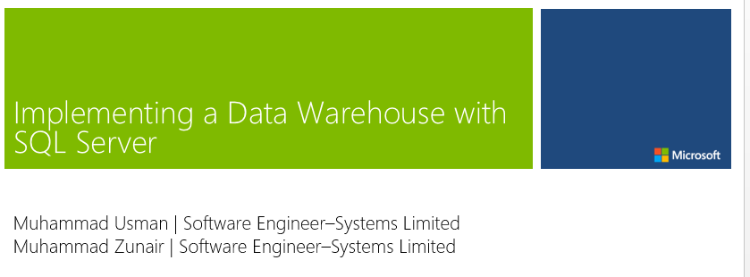

Slide 2

Meet Muhammad Usman
Muhammad Usman | Software Engineer
Focused on Data Science, BI and development technologies
Predictive Analytics, Business Intelligence, ETL, Enterprise Application development
Previous Experience
Teradata Inc. → ETL, Data Warehousing, Visualization
Techlogix → Predictive analytics
Netsol Tech→ Enterprise Application development

Slide 3

Meet Muhammad Zunair
Muhammad Zunair | Software Engineer
Areas of interest: Cloud Computing and Data Science
Web Application development, Prescriptive Analytics and Data Visualization
Previous Experience
Techlogix → Prescriptive analytics
SMEDA → Business Automation
LUMS → Hyper Graph based tool for Pathway Prediction

Slide 4
Why this lab is important?

Slide 5
Because you will be trained for the hottest jobs roles in the market.
Don’t know those roles yet?
Don’t worry, today is the day to learn them.
Also, this is probably the first and last time in the course of your entire degree that you will play with data to get insights.

Slide 6
Responsibilities of a Data Analyst/ Data Scientist
Clean and prune data to discard irrelevant information
Analyze and interpret results using standard statistical tools and techniques
Pinpoint trends, correlations and patterns in complicated data sets
Identify new opportunities for process improvement
Provide concise data reports and clear data visualizations for management

Slide 7
Technical Skills Required
Statistical methods and packages (e.g. SPSS)
Data warehousing and business intelligence platforms
SQL databases and database querying languages
ETL frameworks
Database design
Data mining
Data cleaning and munging
Data visualization and reporting techniques

Slide 8
Data Analyst/ Data Scientist Pay Scale(Mid Career)
Robert Half Technology 2015 Salary Guide Average Salary (2015): $70,750 – $108,250 Average Salary (2016): $74,500 – $114,500
Glassdoor Average Salary (2015): $62,379 per year Minimum: $45,000 Maximum: $90,000
PayScale Median Salary (2015): $52,980 per year Total Pay Range: $34,802 – $79,927

Slide 9
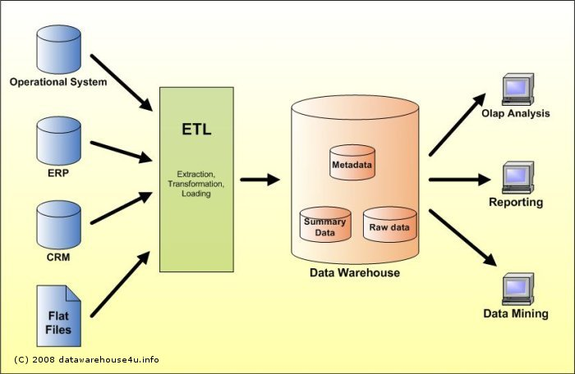
Data Warehouse Architecture

Slide 10
Lab Structure
Implementing a Data Warehouse with SQL Server
01 | Design and Implement Dimensions and Fact Tables | 04 | Control Flow
02 | Data Flow - Extract Data | 05 | Configure and Deploy SSIS
03 | Data Flow - Transform Data | 06 | Manage Enterprise Data

Slide 11
Welcome Back
Lab2

Slide 12
Recap
Introduction
Importance of Lab
Data warehouse Architecture
Lab Structure
Dirty hands with data (Pivot Charts)

Slide 13
Recap
Pivot Charts
Purpose: Work a little bit like data analyst
How: Convert raw data into useful business information
Business Information → Business Decisions

Slide 14
Agenda for Today
Understand some prerequisite of data warehousing
How data can be migrated from one system to other?
Data recovery
Why Important?

Slide 15
If not understand, no problem, you will understand it during your project.

